Slide 1
First 5
9 + 7 × 2 =
20% of $2,300 =
1.35 km = _________ m
A rectangular prism is 6cm x 2cm x 100cm, what is its volume ?
Estimate 423 x 198

Slide 2
First 5 Answers
9 + 7 × 2 = 23
20% of $2,300 = $460
1.35 km = ___1,350 m
A rectangular prism is 6cm x 2cm x 100cm, what is its volume ? 1,200 cm³
Estimate 423 x 198 400 × 200 = 80,000

Slide 3
Topic: metric units of mass EQ: How to use units of mass?
Year 11 Essentials

Slide 4
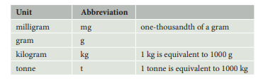
24
7
30
Topic: Measurement
EQ: How to use units of mass?
What are the units of mass?
When I say my weight is 85 kg, it’s the same as saying my mass is 85 kg.
In the metric system, the gram is the basic unit of mass. All other mass units are based on the gram.

Slide 5
24
7
30
Topic: Measurement
EQ: How to use units of mass?
How to convert between metric units of mass?
Example: express 750 kg in
a. grams b. tonnes
The conversion factor between g and kg is 1000. Changing to a smaller unit, we multiply by the conversion factor:
750 kg = 750 × 1000 g
= 750,000 g
The conversion factor between kg and t is 1000. Changing to a
bigger unit, we divide by the conversion factor:
750 kg = 750 ÷ 1000 t
= 0.75 t

Slide 6
24
7
30
Topic: Measurement
EQ: How to use units of mass?
How to convert between metric and non-metric units of mass?
Example: American Airlines only allows strollers that have a mass of 20 pounds or less. Rachel’s stroller has a mass of 8.5 kg. Will she be able to take her stroller?
1 kg = 2.2 pounds
Pounds are smaller than kg, we could divide 20 pounds by the conversion factor to change it to kg:
20 pounds = 20 ÷ 2.2 kg
= 9.09 kg
The maximum mass allowed is 9.09 kg. Rachel’s stroller is only 8.5 kg, so she can take her stroller.

Slide 7
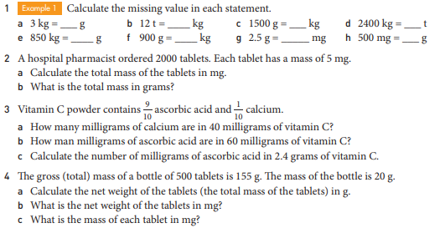

Slide 8
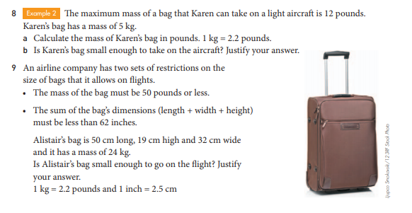

Slide 9

Thank you
Keep up the good work!

